Slide 1
Accessories for the CS6080 Companion Scanners
By MSS Software

Slide 2
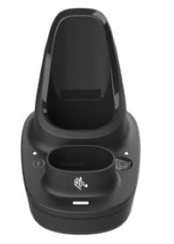
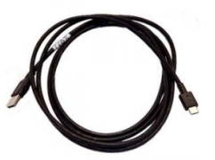
Accessories
Item: MCR6080-SC100F4WW For connecting your CS6080 to your PC as well as charging the device and one battery. Requires MCBL-CS6-S07-04 (Sold Separately.)
Item: MCBL-CS6-S07-04
For connecting your CS6080 Dock to your PC.

Slide 3
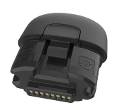
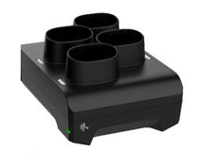
Accessories
Item: MBTRY-CS60EAB0E-04
Spare Battery for CS6080 Scanner.
Item: MCR6080-BC40004WW
For charging up to 4 batteries for CS6080 Scanners. Requires M23844-00-00R (Sold Separately.)

Slide 4
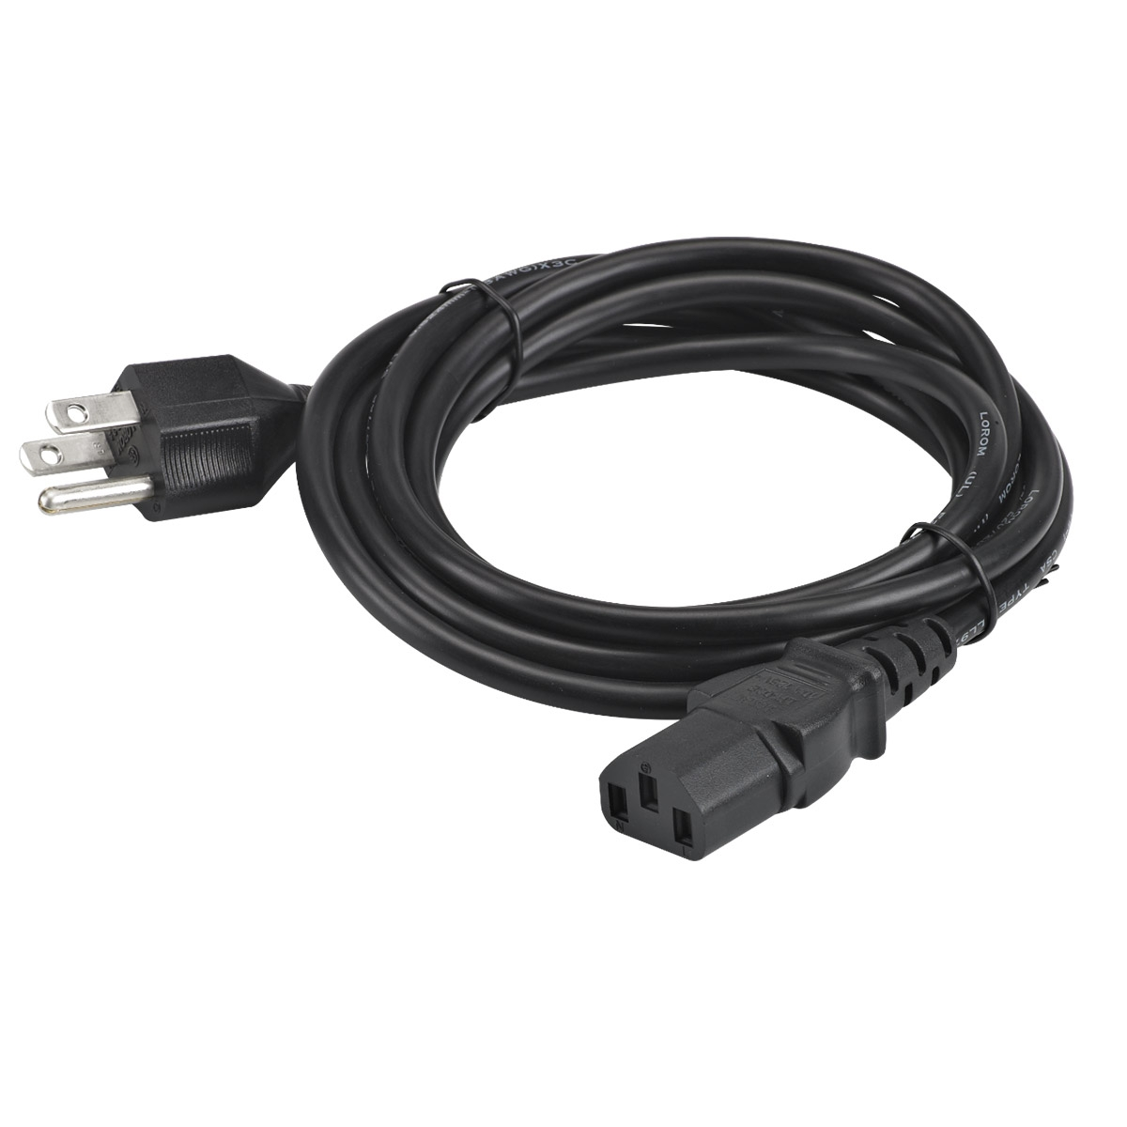
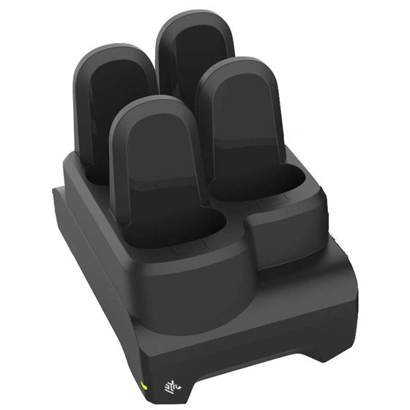
Accessories
Item: MCR6080-SC400F4WW
For charging up to 4 CS6080 Scanners. Requires M23844-00-00R (Sold Separately.)
Item: M23844-00-00R
US Power Cord for CS6080 Chargers

Slide 5
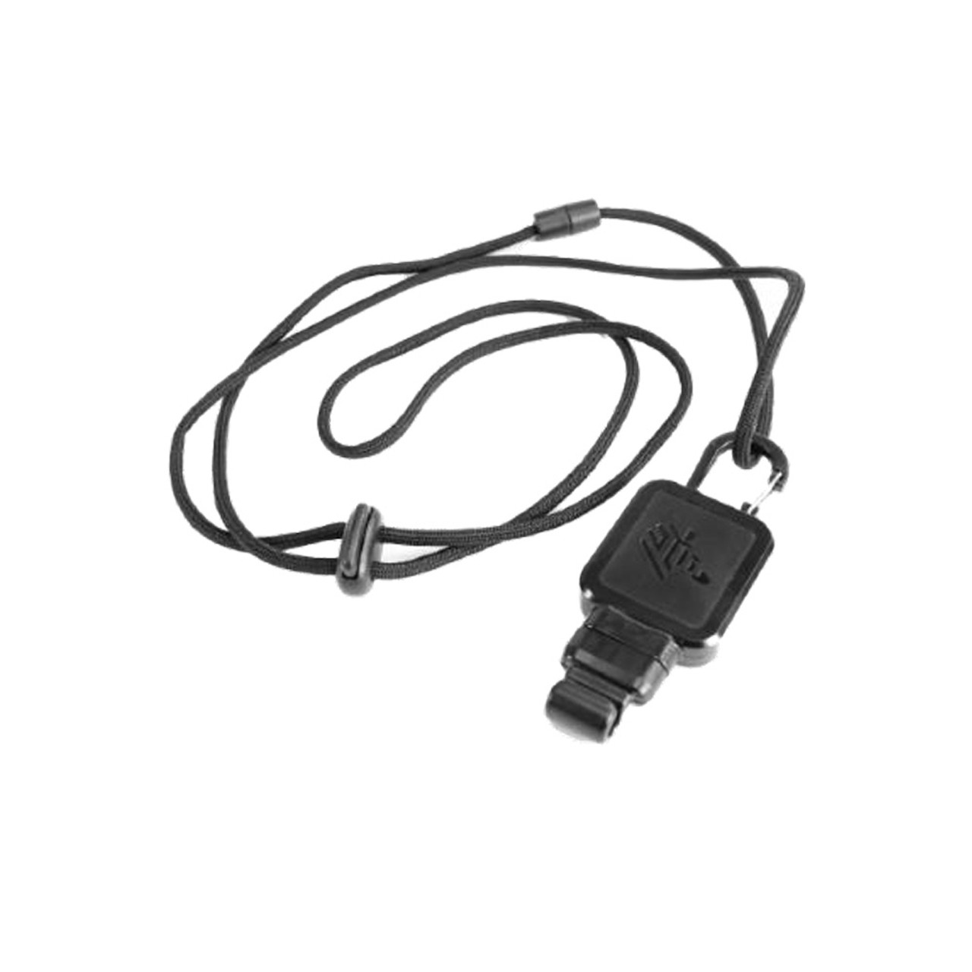
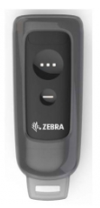
Accessories
Item: MHLSTR-SP0060W-00
Silicone protecter for CS6080.
Item: MLNYD-000060W-04
Lanyard for CS6080 Scanner. Requires MHLSTR-SP0060W-00

Slide 6
Service
MSVC-CS6X
3 Year Extended Support & Maintenance for Scan Wedge Software and Scanner Warranty. Comprehensive Coverage. Available to New Purchases Only.

